Slide 1


Abstra
Lazar Milicevic
Weekly support report
Support, Challenges, Sollutions
17.06.2025

Slide 2
Agenda
1. Zendesk Ticket Management & Optimization
3. Reported & Tracked Issues
5. Next Steps
2. Infra & Product Coordination
4. Visual & Helpdesk Improvements
6. Q&A

Slide 3

Zendesk Support & Performance Update
Customer success: Weekly Support Report – 17.06.2025
What was done:
Support Rotation: Every Monday continuously – Set up Agent rotation
K-Navigator Login Issue (Cillian Ross): Enabled account manually
JumpCloud Access (Mathia Haure-Touze): Clarified no direct access – redirected to IT support Slack channel and offered to follow up if needed
Provided feedback to Frontend and Infra teams on real vs. expected onboarding flow
Coordinated with Marketing to align technical implementation before launching reactivation emails for the previously rejected users from K-Navigator.
Participated in internal planning for fallback workflows and manual override mechanisms related to K-Navigator scaling

Slide 4
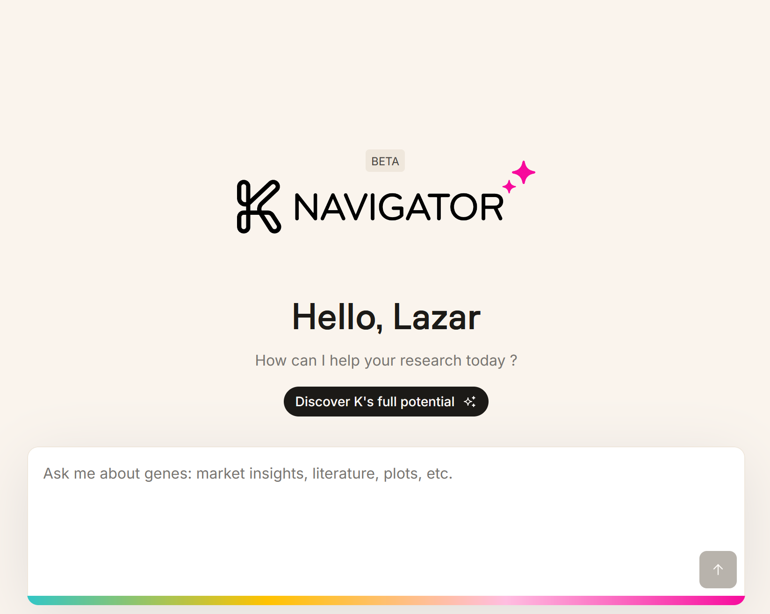
Infra & Product Coordination
Customer success: Weekly Support Report – 17.06.2025
Where we are now ?
Coordinated external user onboarding (Mosaic)
Working on the detecting different Owkin K issues, and reporting them.
I have now Cursor Admin access, currently managing Cursor related req
WireGuard VPN access for multiple external users uests and approvals.
Setup with setup guides and live calls.
Held multiple 1:1 sessions with Hackathon users to restore access after IP changes
Collaborated with Product, AI, and IT teams on onboarding flow improvements and permission coordination

Slide 5
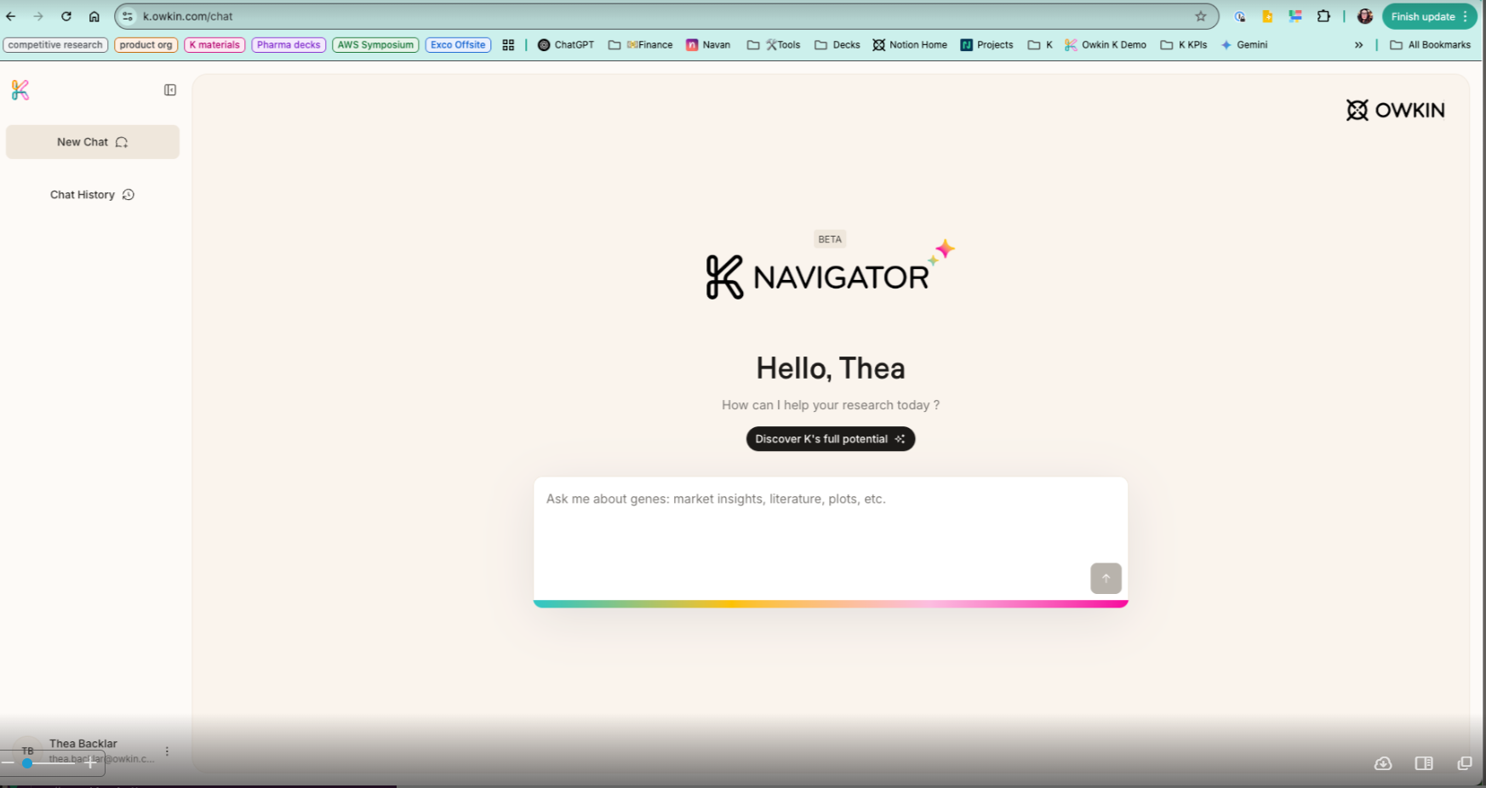
Reported & Tracked Issues
Customer success: Weekly Support Report – 17.06.2025
Some of them:
Closely monitored end-to-end onboarding for Abstra external users:
Manual account creation in Keycloak
Automated Terms of Use email and OTP setup
Manual Zendesk email with instructions for accessing Abstra
Identified users who didn’t complete Abstra login; cross-checked tickets and followed up directly.
Hosted multiple 1:1 onboarding sessions with Abstra external users (e.g. Mosaic, Hackathon), resolving access and login issues
Supported Hackathon participants facing IP change issues, resolved via live sessions
Collaborated closely with Ewa Kondratowicz to align Cognito data, onboarding flow and marketing expectations
Flagged edge cases of users present in Keycloak but not visible in Abstra — contributed to refining the access flow

Slide 6

Visual & Helpdesk
Customer success: Weekly Support Report – 17.06.2025
✅ 3 Zendesk onboarding sessions completed
– Presented Zendesk features, support process, and internal tools
✅ Created Zendesk view for Owkin K signups tracking
– To support easier Cognito approvals
Maintained and improved the daily Zendesk signup report script:
Integrated external email mapping
Output includes multi-tab Excel file (raw + summary)
Improved date validation and fallback logic
Confirmed deprecation of manual macros for approval — accounts will be now auto-enabled by default
Participated in the K-Pro Taskforce, contributing to the new automated approval flow design
Manually re-enabled over 200 previously rejected accounts in one day to prepare for reactivation
Shared a clean list of reactivated users with Marketing for re-engagement campaigns
Continued daily manual review of new signup requests for K-Navigator
Reported user experience issues, including:
K sign-up button cut off on Safari – iPhone 16 Pro

Slide 7
Next Steps
Customer success: Weekly Support Report – 17.06.2025
?
📥 Continue daily signup report exports to Google Drive
✅ Finalize access setup for Ewa
👥 Guide Ewa through full onboarding lifecycle
🎯 Monitor widget behavior in FullStory regarding K-Navigator
🔄 Support the transition to automated approval workflow, adjust based on real user behavior

Slide 8

Q&A
Customer success: Weekly Support Report – 03.06.2025
?

Slide 9
Thank you!

